Slide 1
Wheelchair fall detection
Under the guidance of Prof. BINCY JOSEPH
By Abhishek Bhattacharjee, Abhay Rajbhar, Jaydeep Patil and Aaron Carvalho

Slide 2
Table of Contents
Literature Survey
Problem Statement
Flowchart
Implementation Details
References

Slide 3
LITERATURE SURVEY
Title | Author | Published | Remarks
Wheel-chair person fall detection with Internet of things | Raed Abdulla, Dr.Sathish Kumar Selvaperumal, Chandrasekharan Natraj | Article in solid state technology | Approach towards the project
An IOT based fall detection system | Devanch Kumar Garg, Gauri Rao | IJITEE | How to implement machine learning algorithm in the system
Insights on an automated fall detection device designed for older adult wheelchair and scooter users | Laura A. Rice, Alexander Fliflet, Harshal Mahajan | ELSEVIER, disability and health journal | Basic theory for a fall detection system
IOT based wheelchair detection system | Sayali M.Kamble, Pratiksha R. Kawle, Suwarana S.Mohile | IJRASET | Approach towards architecture and design of the system

Slide 4
Problem Statement
To design a system which is able to detect abrupt movement on the wheelchair
The system then should be able to send a distress single to the family member of the patient

Slide 5
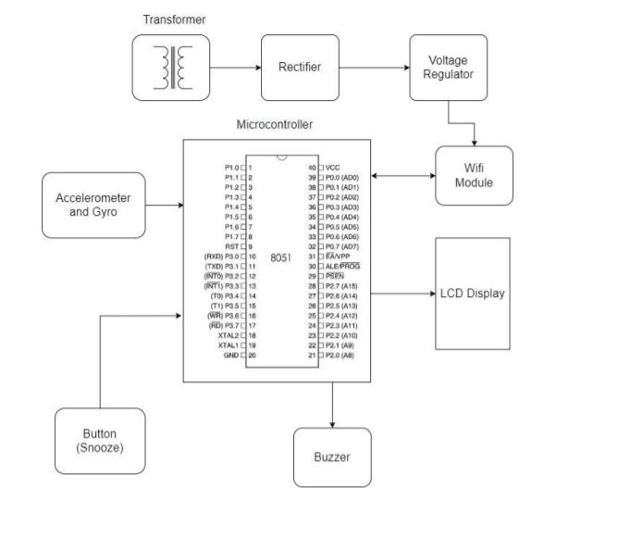
Block Diagram

Slide 6
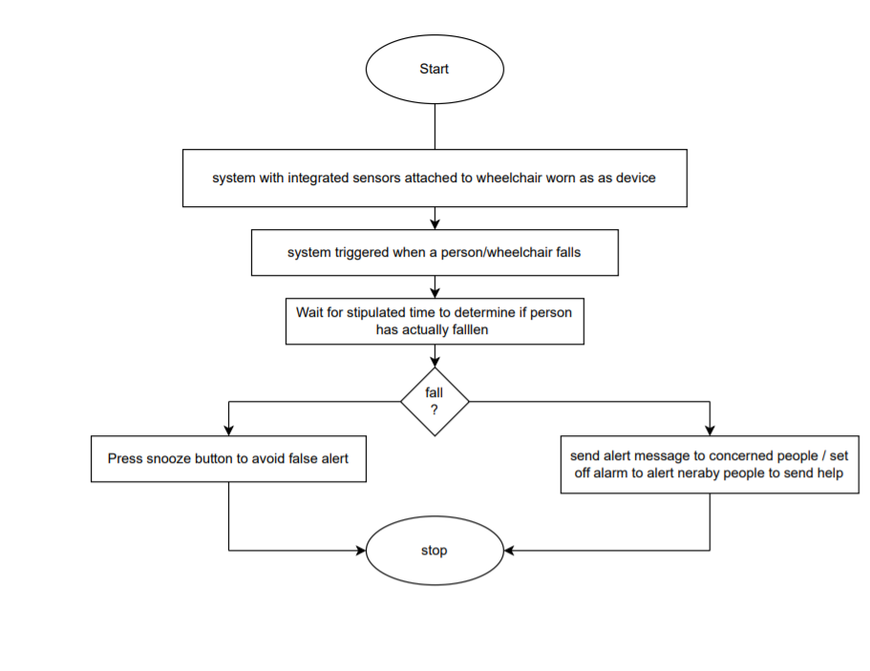
Flow chart

Slide 7
Implementation Details
The system uses accelerometer and gyro sensor to detect person movements, It can be mounted on persons hand or wheelchair for detection. The sensor is connected to a microcontroller in order to constantly transmit the acceleration data.
Now the system keeps monitoring for fall detection and abrupt movement changes in person. A sudden abrupt change with jerk in the system is treated as a fall.
Now in case the person did not fall and alarm was false, the system allows to snooze the alert if person presses snooze button in 5 seconds.
If person does not press the snooze, system detects person has fallen and automatically triggers alert through wifi connection to alert the loved ones of the person about the situation instantly.

Slide 8
References
International Journal of Innovative Technology and Exploring Engineering (IJITEE)ISSN: 2278-3075, Volume-9 Issue-6, April 2020
Disability and Health Journal Volume 15, Issue 1, Supplement, January 2022, 101207
Wheel chair person fall detection with IOT Solid state Technology volume 63 2020 issue-1st
An IoT Based System to Detect a Person/Wheelchair Fall” Authors: Dr.H. Shaheen, E. Himabindu, Dr. T. Sreenivasulu, Dr. Rajasekar Rangasamy, IJET, 2015.

